Slide 1

Stéphanie Krus
Senior Service Designer
Department for Work and Pensions

Slide 2
How a service designer can contribute to accessibility

Slide 3
“Personalised public services”
An invite to explore how services can be designed around the individual needs, circumstances and experiences of the people who use them…
+ people who are delivering them
+ those involved in designing them
Notes:
This year’s theme is “Personalised public services” – an invite to explore how services can be designed around the individual needs, circumstances and experiences of the people who use them.
But I’m a service designer so I’m going to extend the theme and also look at the needs of the people who are delivering the service and those involved in designing them

Slide 4
What I will take you through
how we created the guidance
making your service accessible
design communication
designing together
key takeaways and resources
Notes:
I will use the guidance for the service designer role from the DWP accessibility manual as a thread to take you through

Slide 5


About me
my pronouns are she/her
have been a software developer
a UX designer and researcher
now a service designer
very keen on accessibility and inclusion
2016
2018
2019
Notes:
my pronouns are she/her,
I’m French in case you are still wondering about my accent.
I started working in government in 2016 as a software developer for the Ministry of Justice
I became a UX designer and researcher for a council in 2018,
then transitioned again to service design in 2019
and now working for DWP since 2023, first as a contractor and now as a permanent.
During all that time, I’ve always been very keen on accessibility and inclusion

Slide 6
Each role in a multi-disciplinary team has a part to play to avoid making a service inaccessible
Notes:
Because of my experience going from one role to another, I’m very aware that each role in a multi-disciplinary team has a different part to play to avoid making a service inaccessible.
It works better if everyone knows their part, so that the accessibility of a service do not rely on one single very keen individual reminding everyone what they should be doing.
This is why guidance per role feels really important to me.

Slide 7
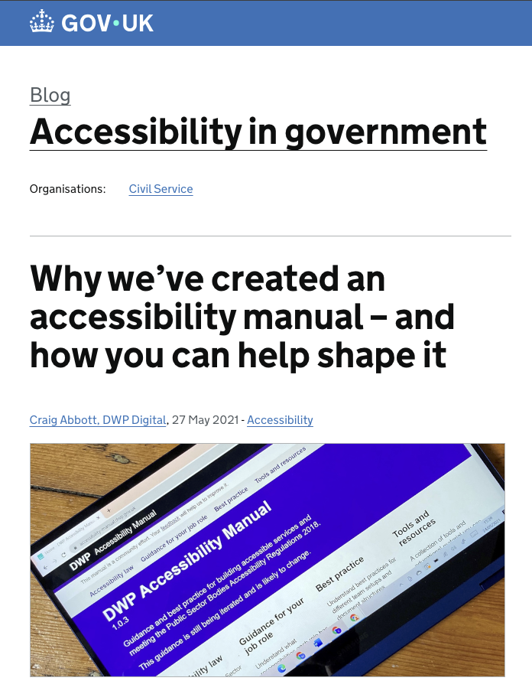
DWP Accessibility manual
How we created the guidance for the service designer role
Notes:
When the manual was first created in 2021, it was unique. Nothing like that existed in government even though it was badly needed.
Now there is also the DfE accessibility and inclusion manual but in terms of guidance per role, they do not have much yet.
The manual was very useful and very well received at the time. My favourite part was the guidance per role, so I started pointing people to it during my presentations, at work, or outside work,
There was a guidance for pretty much all the role we have in a multidisciplinary team in government, but not for the service designer role.

Slide 8

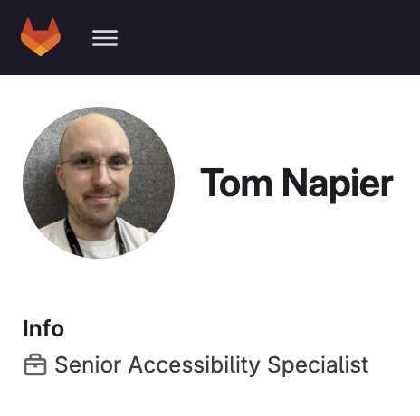
Joining DWP in 2023
2 reasons:
not enough time
unsure what a service designer does
Notes:
When I joined DWP in 2023 as a contractor, I talked to Tom Napier, he is a senior accessibility specialist.
I contacted him about the project I was on, but in the conversation, I mentioned the manual and it turned out he was the one in charge of maintaining it,
I told him how I kept directing people to the manual even before I joined DWP, but that the service designer role was missing in it.
There were 2 reasons, not enough time at that point, but also he was unsure about what a service designer does and how this contributes to accessibility.
Which is was not surprising to me, because every time I join a project team, no one seems to be too sure about what a service designer do …. apart from creating maps maybe?
I keep having to explain what I do.
But Tom was happy to work on a guidance with me.

Slide 9
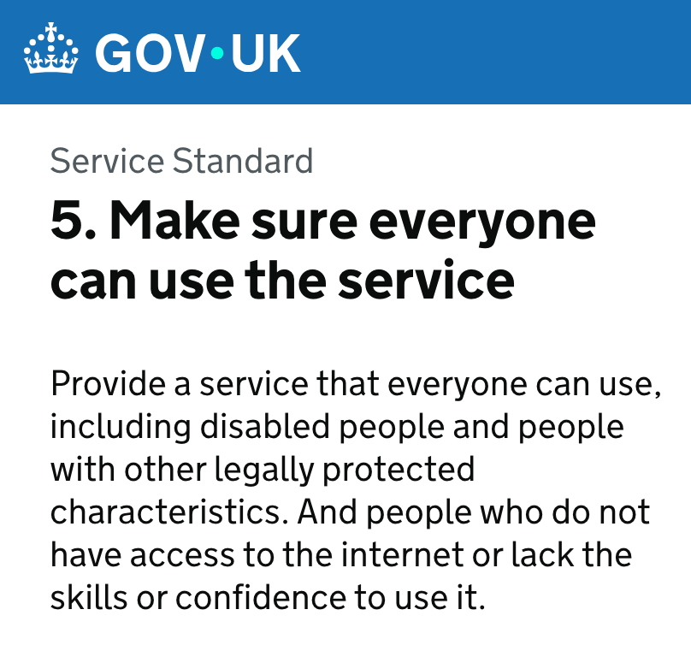
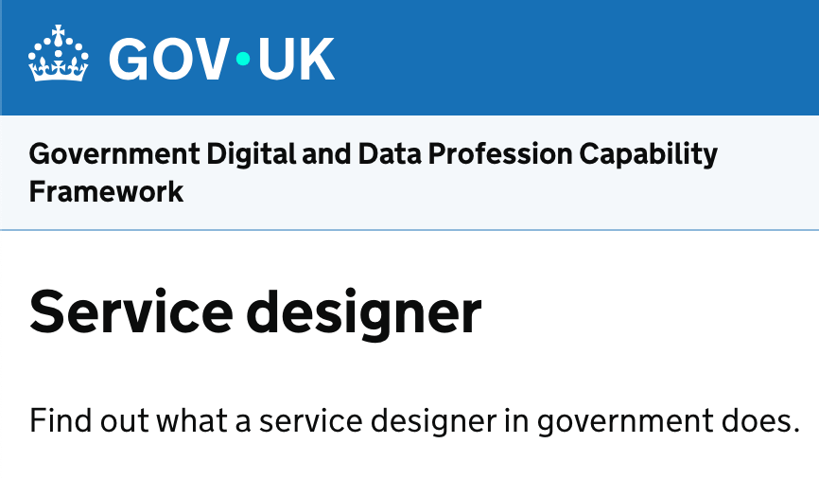

The service designer role
My own practice
Notes:
I was very happy about this and started looking at:
point 5 of the service standard which describes what is needed to make sure everyone can use the service, which includes disabled people.
I also looked at the guidance of the Department for Education’s guidance on how to apply the service standard for point 5 as they go in a bit more details
I’ve checked the description of the service designer within the Government Digital and Data Profession Capability Framework
and finally I’ve added elements from my own practice as a service designer
That’s all the material I had to start working on a guidance.

Slide 10
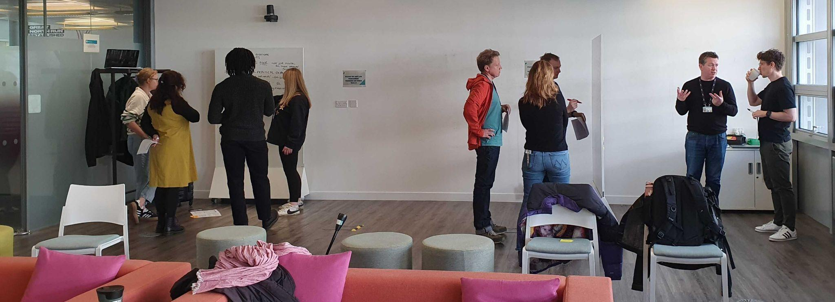
Involving the Service Design Community
Notes:
That was my initial plan, but I wanted to involve the wider service design community in DWP too, because I’m just one service designer, and there are different ways to practice service design.
So we work on it in 3 phases:
one online service design community session where we had invited Tom so he could hear first hand what we felt our role was regarding accessibility.
Tom worked on a draft guidance based on this.
And then during an in person community day in March, we worked in groups to refine the guidance and it got much better as a result.
I’m really glad I involved the community because it took the guidance much further and made it much better than whatever I could have done working by myself with Tom.
Soon after, in April 2025, the guidance was published.

Slide 11
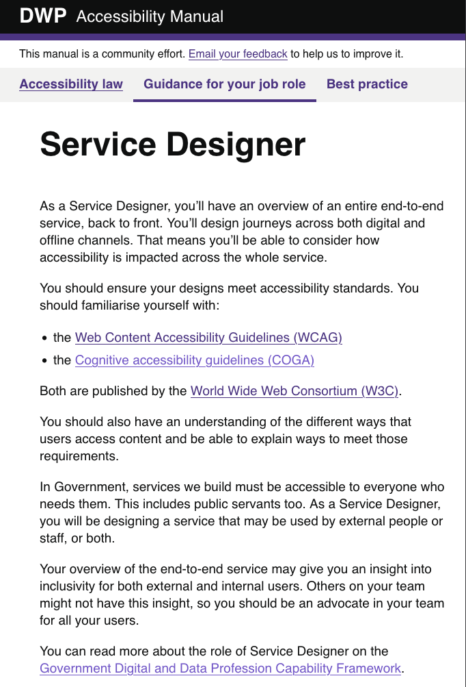
What the guidance covers
WCAG Conformance
Non-digital accessibility
Design communication
Design together
When you can’t make a part of your service accessible
Notes:
Since April 2025, the service designer role has its guidance page.
I’m going to tell you a bit more about the guidance itself now that you now how it came to be created.
It covers the bullet points on the slides, and I’m going to go in a bit more details about each of them during the rest of the talk.
Guidance for the service designer role

Slide 12
What’s different in this role?
“Your overview of the end-to-end service may give you an insight into inclusivity for both external and internal users”
“You’ll design journeys across both digital and offline channels”
Non digital accessibility → Accessible events toolkit from Scope
Notes:
So first, what’s actually different and specific to this role?
Others on your team might not have this insight, so you should be an advocate in your team for all your user, both internal and external.
Parts of your service, as well as some of your design activities, might occur offline. You must consider non digital accessibility too.
The Disability charity Scope has lots of guidance around accessibility in the built environment. Scope provides guidance for users on how to check the accessibility of an event or venue.
This can be useful to understand what things you should consider when parts of your service require people to attend a place in person.
Scope for Business also have an accessible events toolkit that you may find useful

Slide 13
When you can’t make part of your service accessible
a service, technically accessible online might not be the best solution
you can and should ask for help from accessibility specialists
Notes:
There are 2 meanings to this: you are in a situation where an alternative option is a better than spending a lot of time on making a digital solution more accessible
For example, consider the digital self-check-in at Jobcentres. It might be difficult to change accessibility settings if you need to use a screen reader and cannot hear in the busy environment. Speaking to a person could provide a better experience.
Bringing the community along with me to improve the guidance highlighted that some service designers might not know how to make things accessible by themselves. We are not trained to do this, so if no one in your team can help, you need to work with accessibility specialists (in your department, cross government, but you could also bring in associations

Slide 14
Accessibility
Notes:
Just in case some of you are not familiar with accessibility, I’m going to give a quick overview.

Slide 15





1 in 4 people are disabled in the UK
vision hearing speech motor cognitive
It’s different for everyone
Notes:
1 in 4 people are disabled in the UK
A disability can affect your vision, your hearing or your speech.
It can be a physical disability​ or a cognitive disability​,
this means it affects your memory, ​or how you process things, communicate and think​.
It can also be a mix of more than one disability​.
In fact,it’s quite frequent that people have more than one disability
and they are not always visible to others.
It’s different for everyone
Source for 1 in 4 - disability prevalence by age group

Slide 16
Defining accessibility
“Accessibility means that people can do what they need to do in a similar amount of time and effort as someone that does not have a disability.
It means that people are empowered and can be independent.”
Source: GOV.UK Blog post

Slide 17
Web Content Accessibility Guidelines
→ Standard you need to comply with for digital accessibility
Currently, version 2.2
Web Content Accessibility Guidelines (WCAG)
Published by the World Wide Web Consortium (W3C)
Notes:
We have a link to this in the guidance, but it’s not always easy to engage with - The DWP accessibility manual have some more engaging guidance around this

Slide 18
Cognitive Accessibility Guidelines (COGA)
→ set of guidelines for inclusive design
Also published by the W3C.
Nice COGA version by the Department for Education
Notes:
a set of guidelines for inclusive design.
covers a lot of issues around neurodiversity
and was included in the guidance for our role as it’s very useful
The Department for Education has a really engaging version of COGA [ link on the slide]

Slide 19
Neurodiversity
Dyslexia
Autism
ADHD (= Attention Deficit and Hyperactivity Disorder)
Dyspraxia
Dyscalculia
OCD (Obsessive Compulsive Disorder)
Tourette’s syndrome and more
Notes:
Neurodiversity is an umbrella term which cover conditions like Dyslexia, Autism, ADHD
and other ‘dys’ like dyspraxia, or dyscalculia, OCD, Tourette’s syndrome and more. There is a lot of overlap between these conditions.

Slide 20
How neurodiversity affects people
think, process information and language
interact socially and communicate with others
perceive space and time

Slide 21
1 in 7 people are neurodivergent
This is about 15 to 20% of the general population
But it’s often underestimated and under-declared.
It’s much higher for people working in Tech.
→ above 20% and probably up to 50% in tech and the creative industry
Notes:
1 in 7 people are neurodivergent in the UK - that’s about 15 to 20 % of the general population.
It’s often underestimated and under declared because even though things are improving, it’s still often perceived negatively, so people are wary of disclosing.
Many people don’t have a diagnosis, it takes a long time to get one, and some people are not even aware that they are neurodivergent, especially women, as the description of these conditions are still full of stereotypes and more representative of young boys than girls and even less of adult women who often have learned to cope and mask.
It looks like these numbers are much higher for people working in tech.
It’s very hard to have reliable numbers, I’ve got 3 sources which I added to the notes of the slide.
And some of the numbers are showing that it’s above 20% in tech and the creative industry and probably up to 50% in some cases.
So if you consider the people in your team, it’s very likely that quite a few are neurodivergent.
I’ll come back to this at the end when talking about designing with your team and communicating your design.
Major new report from the Tech Talent Charter reveals tech employers massively underestimate neurodivergence - We are Tech women (Feb 2024)
What it’s like being neurodivergent in the creative industries - Creative review (Avril 2024)
Written evidence given to a UK Parliament committee (PDF)

Slide 22
Designing for everyone

Slide 23
General recommendations
1 in 4 people are disabled
think of accessibility right from the start
involve disabled people at every stage of your research
don’t forget internal users
everyone in your team needs to be involved
ask for feedback (accessible and not only online)
Notes:
Some general recommendations
You need to think about accessibility right from the start, not at the very end as it will influence your decisions all along
1 in 4 people are disabled in the UK, so ideally, you should have a similar proportion of disabled people taking part in your research.
Don’t forget internal users, they could also have accessibility issues while delivering the service, so do think about them too.
Make sure everyone in your team understand how to avoid making things inaccessible without meaning to.
Everyone has a role to play.
Make it easy for people to tell you when something is not right.
Even if you have done a really good work, you are likely to overlook some issues, so this feedback is crucial to keep improving your service.
If your feedback mechanism is only online and not accessible, you are going to miss out on a lot of inclusion issues…
So make sure the way you request feedback is accessible and not only online.

Slide 24
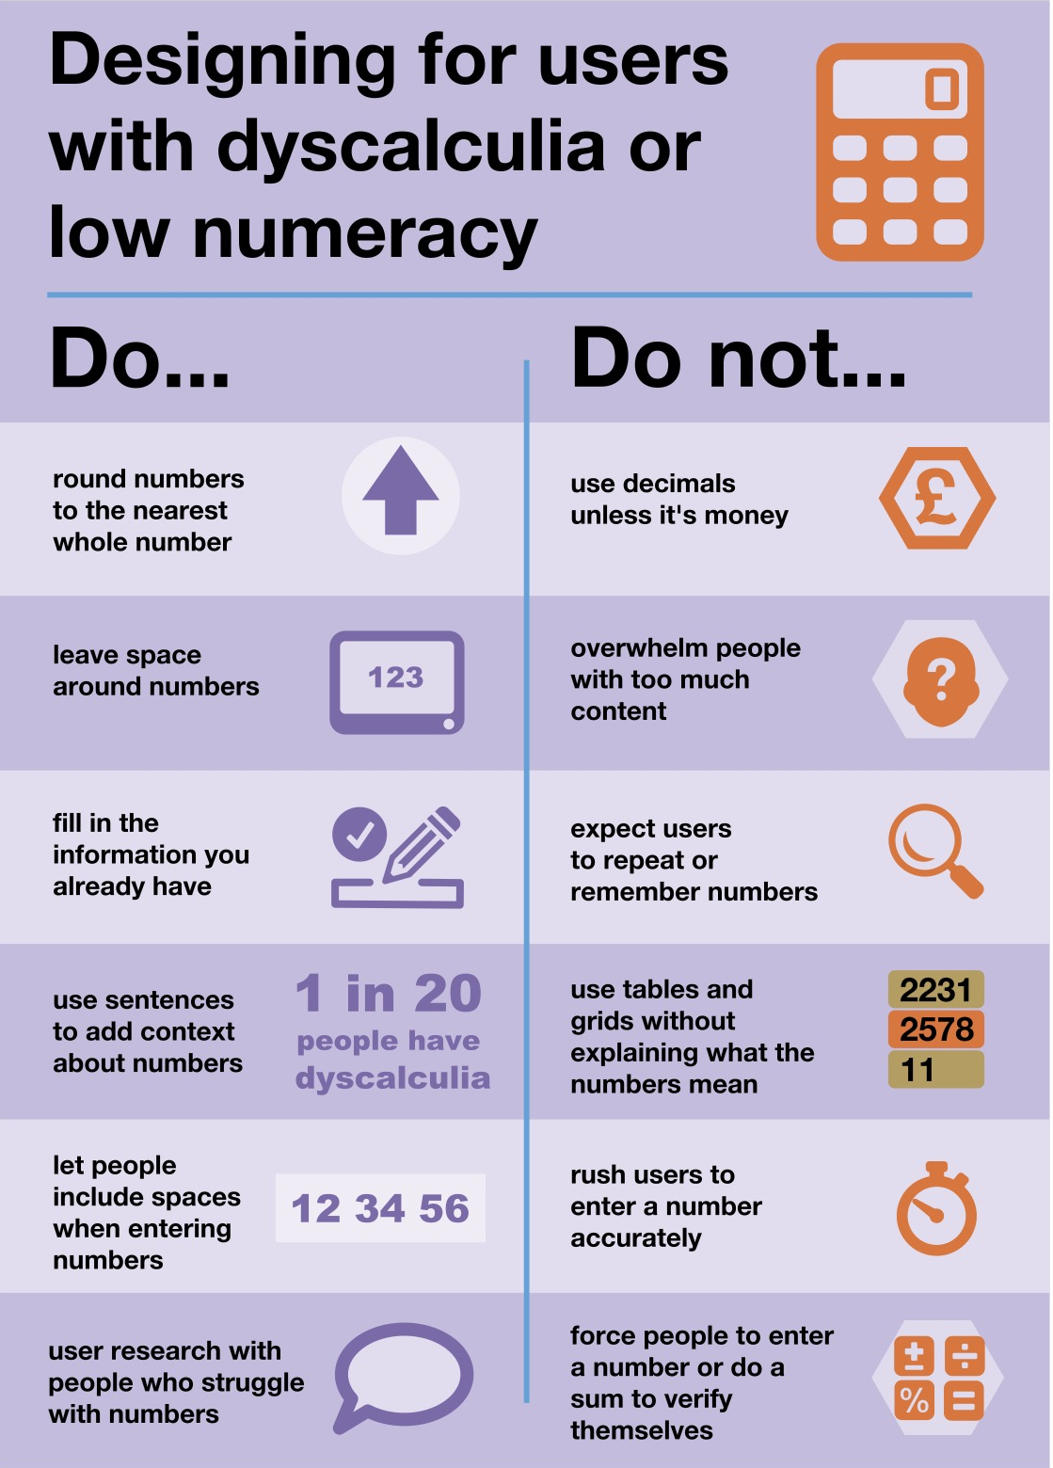
Numbers
Low numeracy affects half the working-age adults in the UK
Accessible numbers project by Laura Parker
Notes:
Don’t forget about users with dyscalculia and low numeracy.
Low numeracy affects half the working-age adults in the UK - this is a lot of people among your users but it could also be your colleagues, in your team or among people delivering the service.
To learn more about this, you can check the Accessible numbers project by Laura Parker, there is advice and podcast episodes to understand how to do better. I really recommend it.
A while ago now, Laura worked with Rachel Malic and Jane McFadyen to create a new do and don’t poster for designing for people with dyscalculia or low numeracy: link to a blogpost explaining how they made this poster.

Slide 25
End-to-End, Back to front
Integration with other services
Asking Questions
Consistency
Service features guidance in the manual
  Redundant entry
  Accessible authentication success criteria
Notes:
In the guidance for a service designer, we have mentioned WCAG which is very wide, but for this role, we wanted to focus on a few points, which relates to the fact that we are the one person looking at the end-to-end and back-to-front service
Integration with other services
You should consider the accessibility of any other services you want to integrate with before deciding to include them in your design. These other services may have an impact on the accessibility of your design. For example, your service may pass the user to an authentication service before returning them to the main journey.
Asking Questions
Many services ask questions for users to answer. You should ensure that you don’t ask the user the same thing over and over.
This can be harder than it sounds. Repeated questions can be difficult to avoid when designing a complex service with many integrations.
Consistency
The way you navigate the service and ask for help should be consistent across integrations if possible. As well as testing features of the service, you should be testing whole journeys.
The DWP Accessibility manual has a Service features guidance part.
Service Designers should pay particular attention to it.
These pages provide more detailed information on the WCAG success criteria to consider.
In particular: Redundant Entry and Accessible Authentication success criteria.

Slide 26
Design communication

Slide 27
Some basic steps
Use legible fonts, and structure your text with the right headings
check colour contrast especially for your text
do not rely on colour alone to convey meaning
use plain language and explain acronyms
be careful with numbers
use accessibility checkers for your slides
send your presentation ahead of the meeting when possible
Notes:
This is really for everyone in the team really not just service designers

Slide 28
Maps
colour contrast are still important, and not just for the text
legible font is still important, but more flexibility on the size
beware: people will look for meaning in colours and alignment
not too much info, not too many colours and shapes
who is your audience? what’s your intent?
create alternative formats
Notes:
This one is more specific to service designer, because people do not always know what a service designer does, but we are usually known as the person ‘who does the maps’.
And these can be powerful tools to communicate your design.

Slide 29
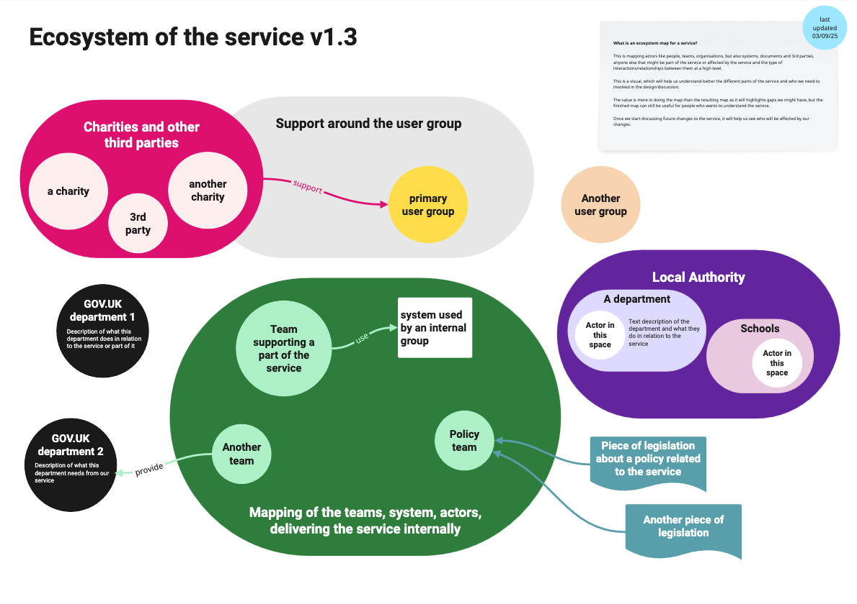
Example:
Mapping an ecosystem
Notes:
On this slide, I have a colourful ecosystem map.
At the top, I usually put a version number for that map, and in the top right corner, I usually explain what an ecosystem is and what we will use this for.
I also add the date when it was last updated.
The map itself show the usual elements I have in an ecosystem:
The primary group of users, and other groups …. potential support around the group, and charities and other 3rd parties. I will have some arrows to show the relationships between these groups
I often have a part showing the teams, the systems and actors who are delivering the service internally, and relations they might have with other government departments. Here I’ve put the policy team and relation to piece of legislation the service needs to comply with
And finally in this example, I’ve put a local authority part and within it departments with potential actors and what they do.
Once the mapping is in a good place, and I want to start sharing wider, I create an alternative format as a slide deck, and provide the same level of information but easier to use and engage for people who do not function visually or feel it’s too much to take in one go.

Slide 30
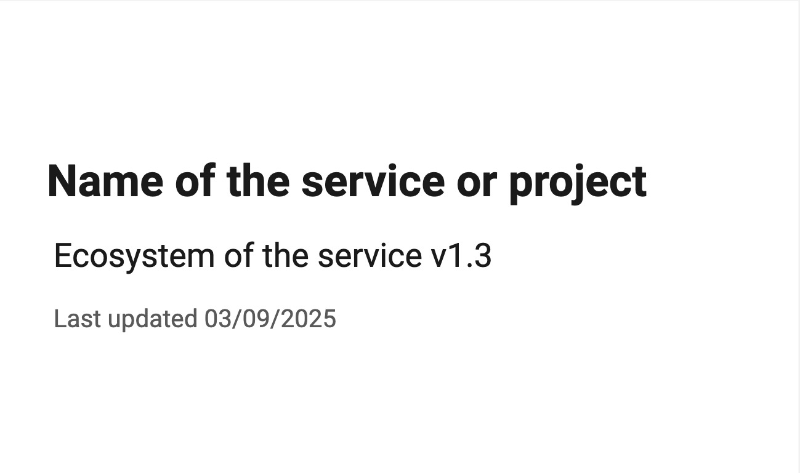
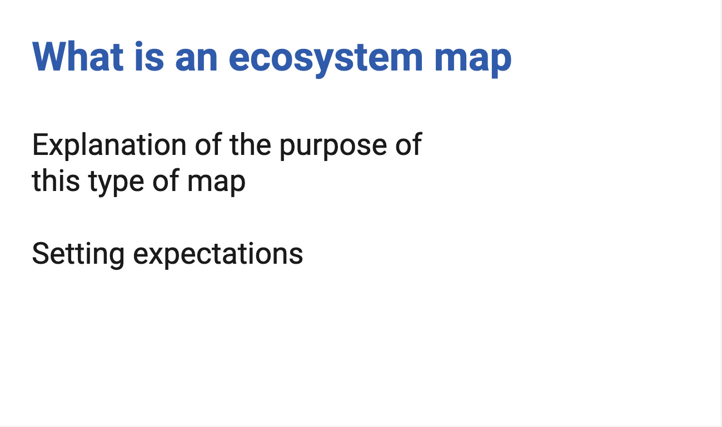
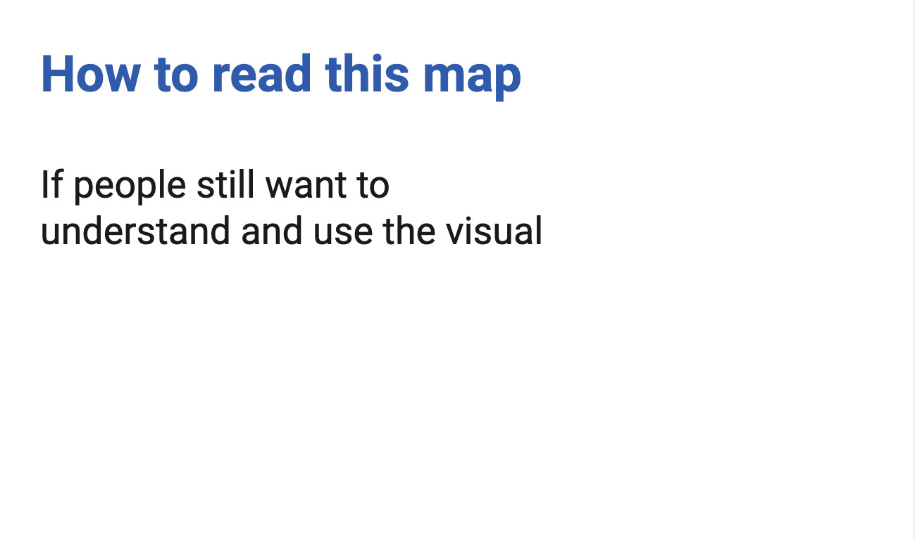
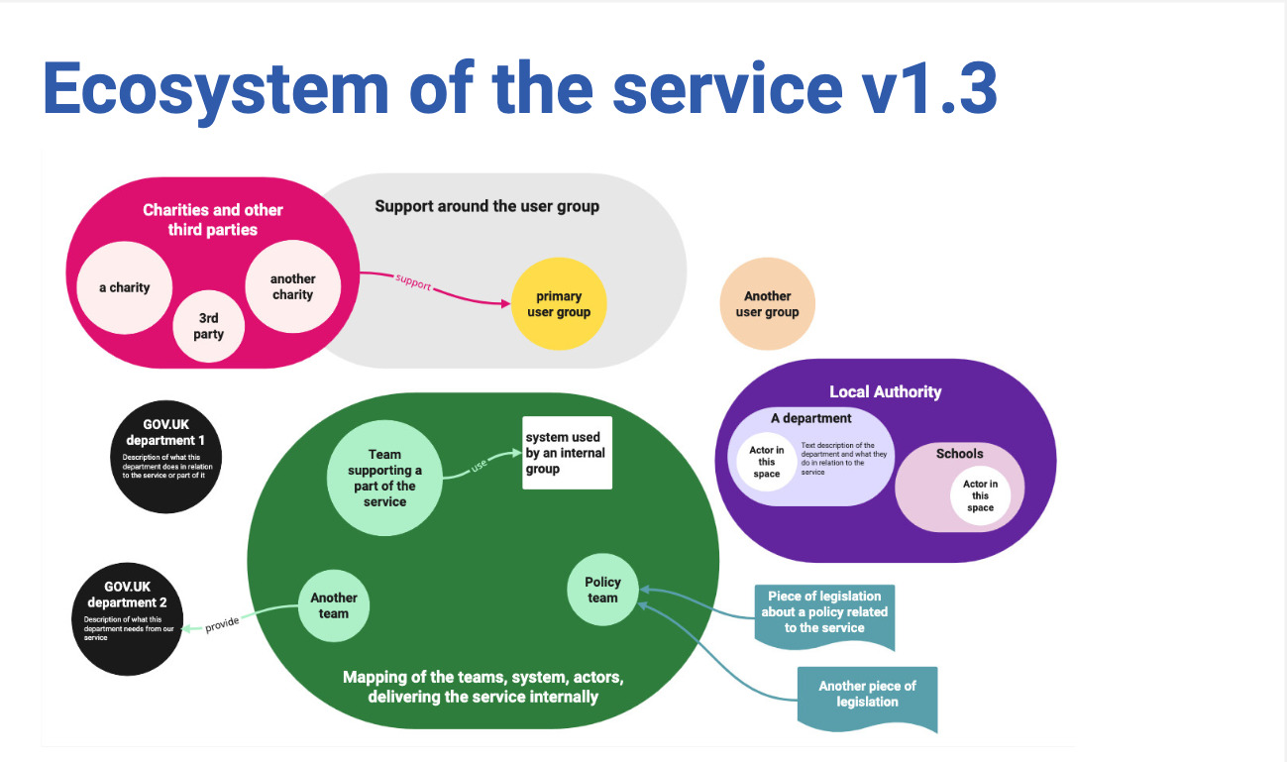
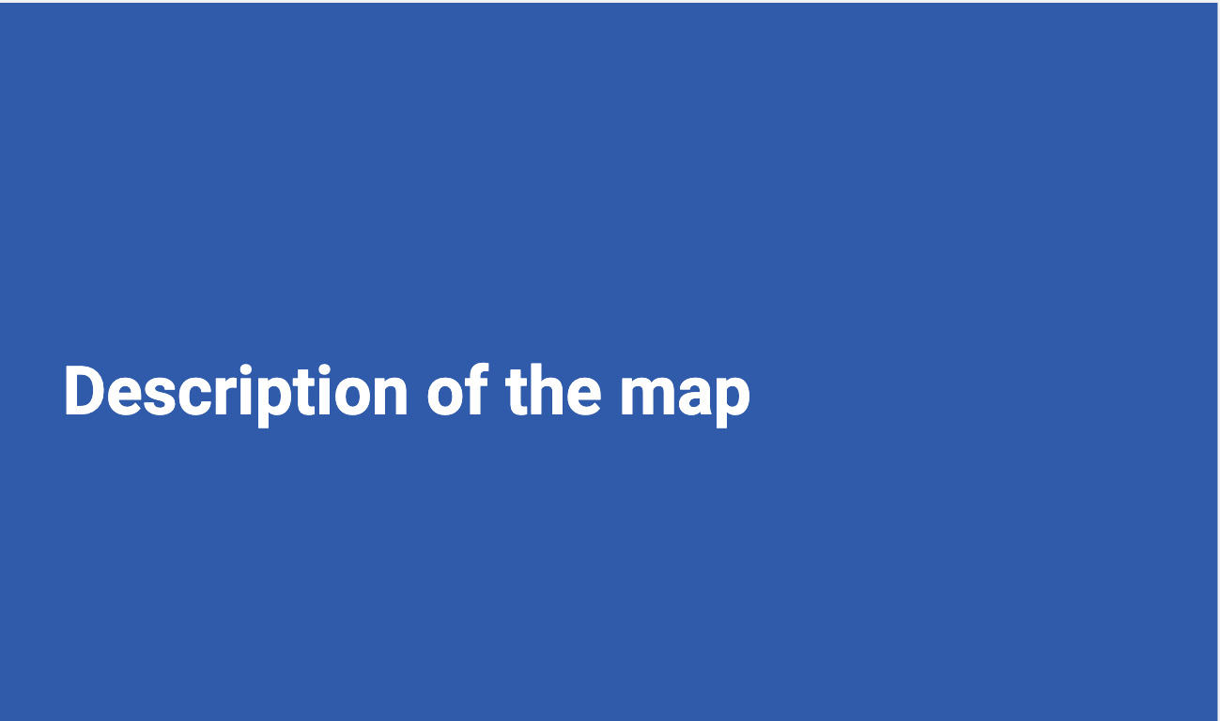
Example: Turning the ecosystem visual into a deck (1)
Notes:
I have an ‘educational slide’ and provide a link to a PDF version of the visual as some people might still be interested in seeing it, and then I provide a written description of the visual.
[explain what an ecosystem is]
“This is mapping actors like people, teams, organisations, but also systems, documents and 3rd parties, or anyone else that might be part of the service or affected by the service and the type of interactions/relationships between them at a high level.
This is a visual, which will help us understand better the different parts of the service and who we need to involved in the design/discussion.
The value is more in doing the map than the resulting map as it will highlights gaps we might have, but the finished map can still be useful for people who wants to understand the service.
Once we start discussing future changes to the service, it will help us see who will be affected by our changes“

Slide 31

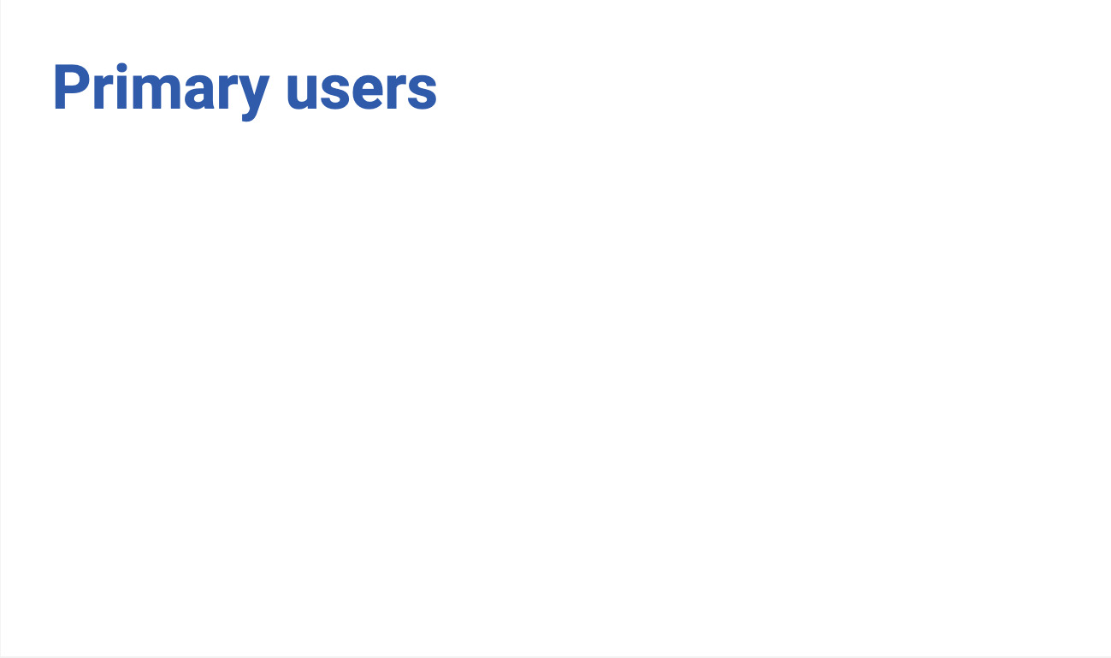
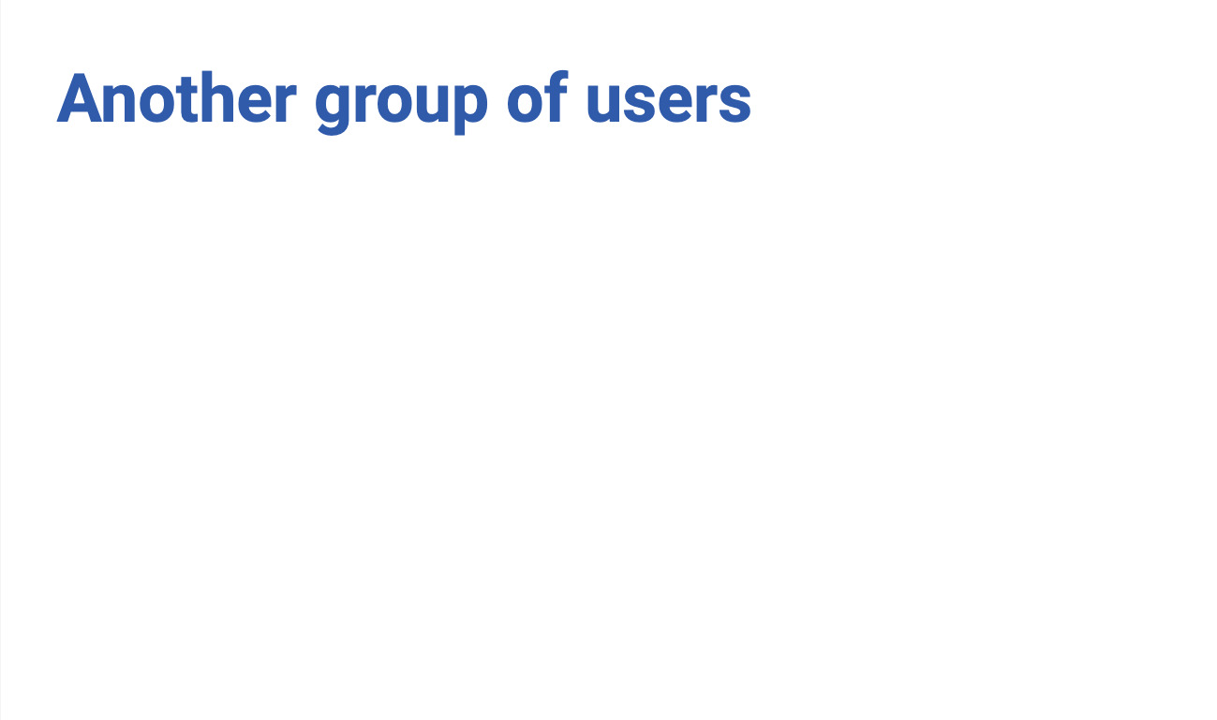
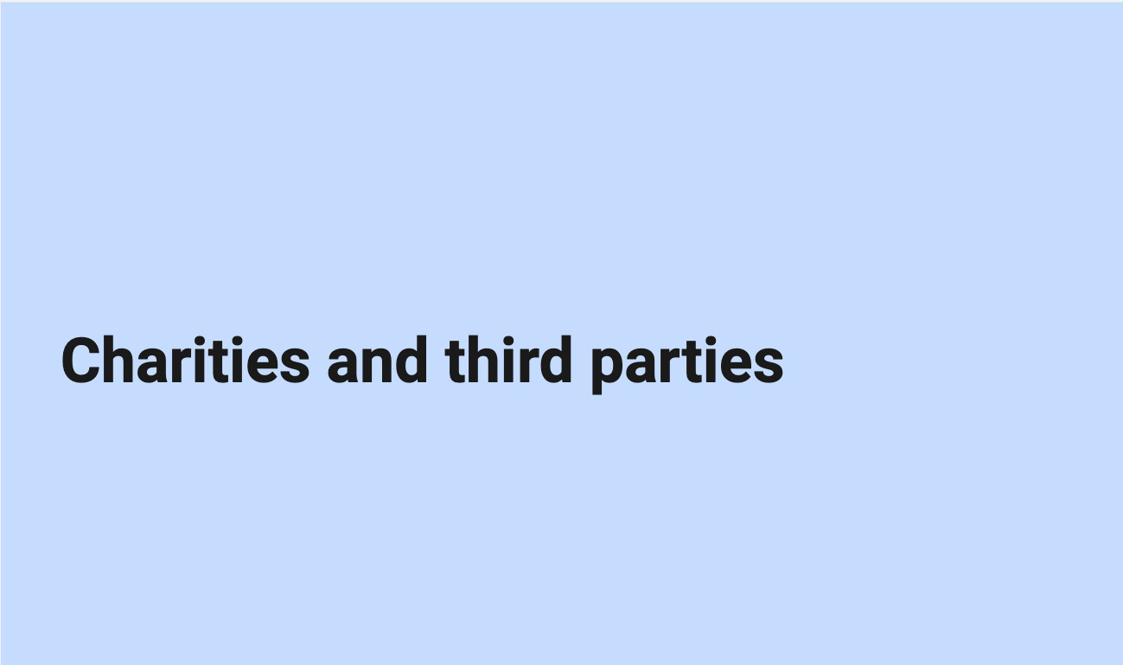
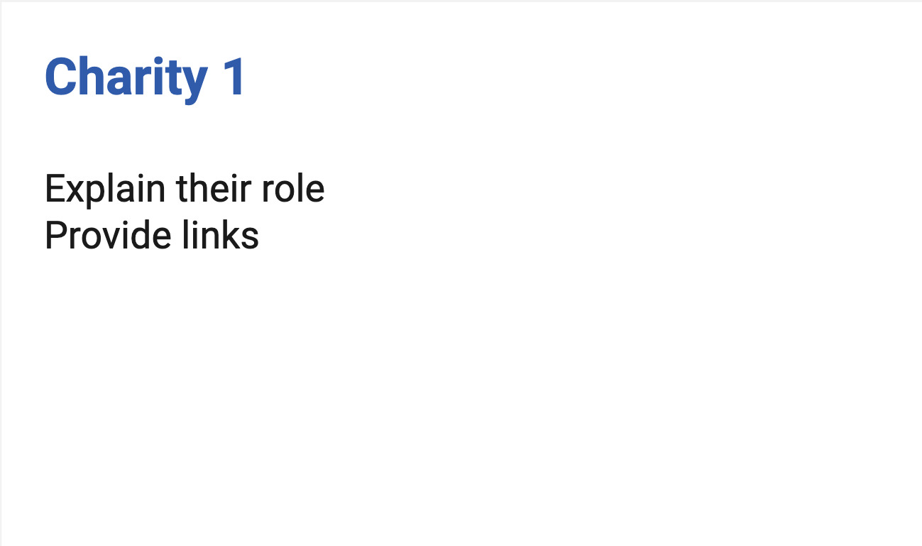
Example: Turning the ecosystem visual into a deck (2)
Notes:
I start with the users, and 3rd parties. In a deck I can provide a bit more information and add links. I describe the relationships which are sometimes less obvious in a deck.
It might have a bit of duplication compared to a visual.

Slide 32
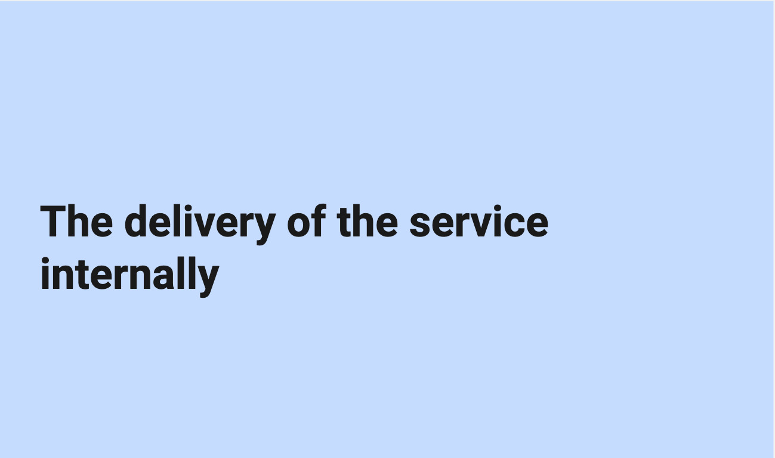
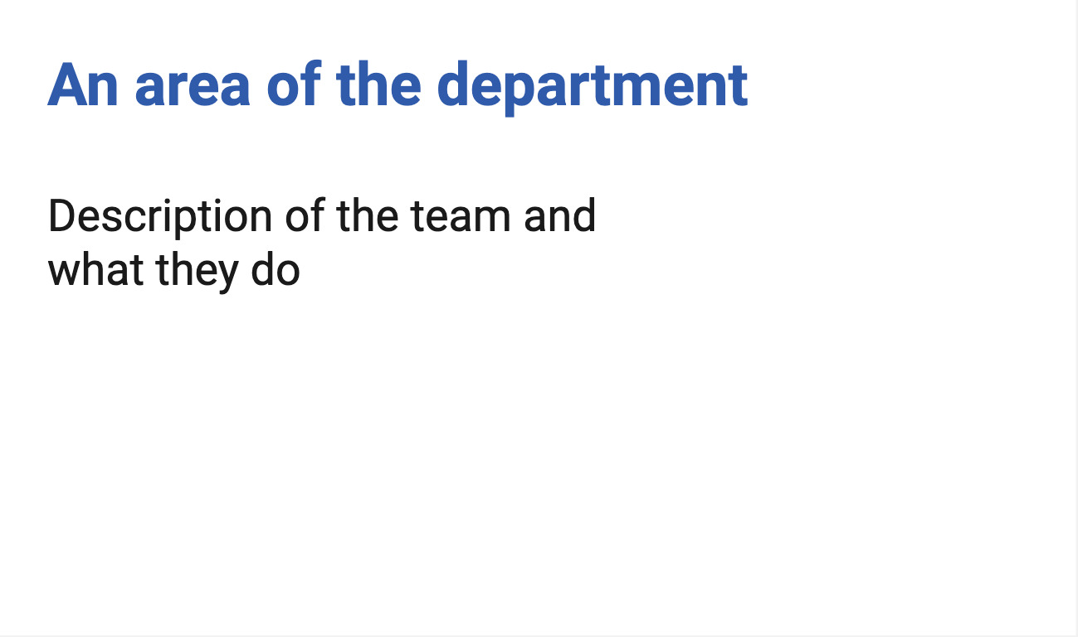
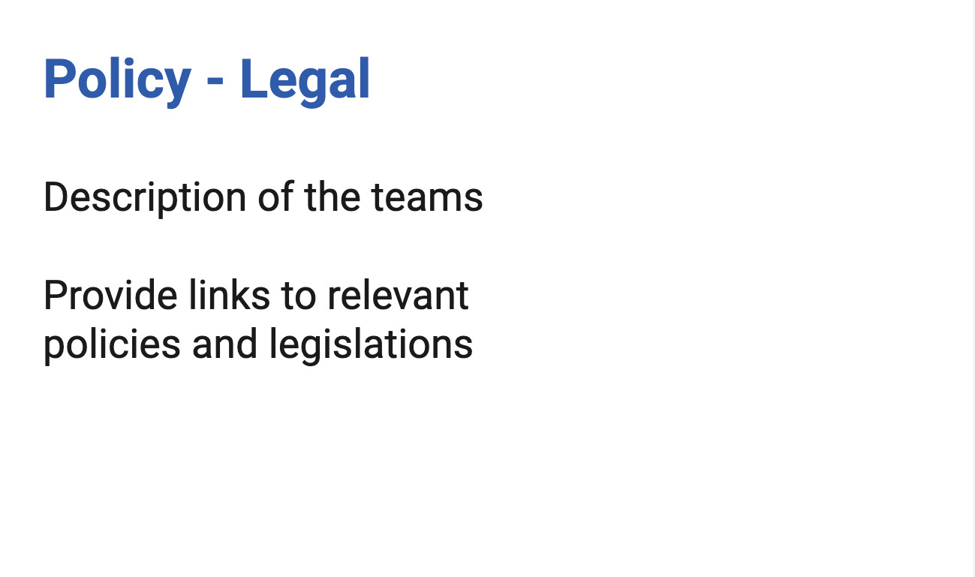
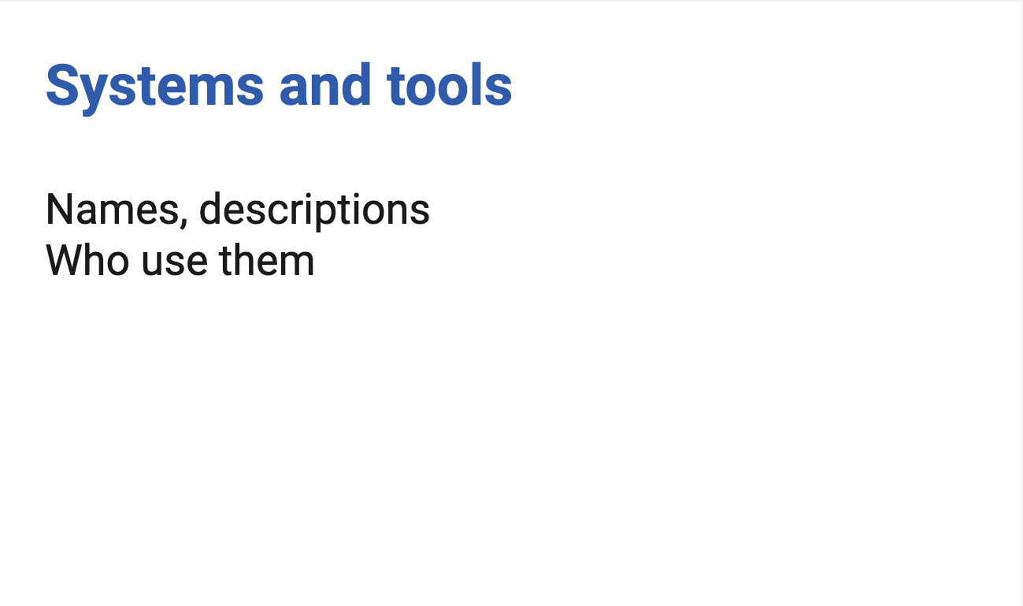
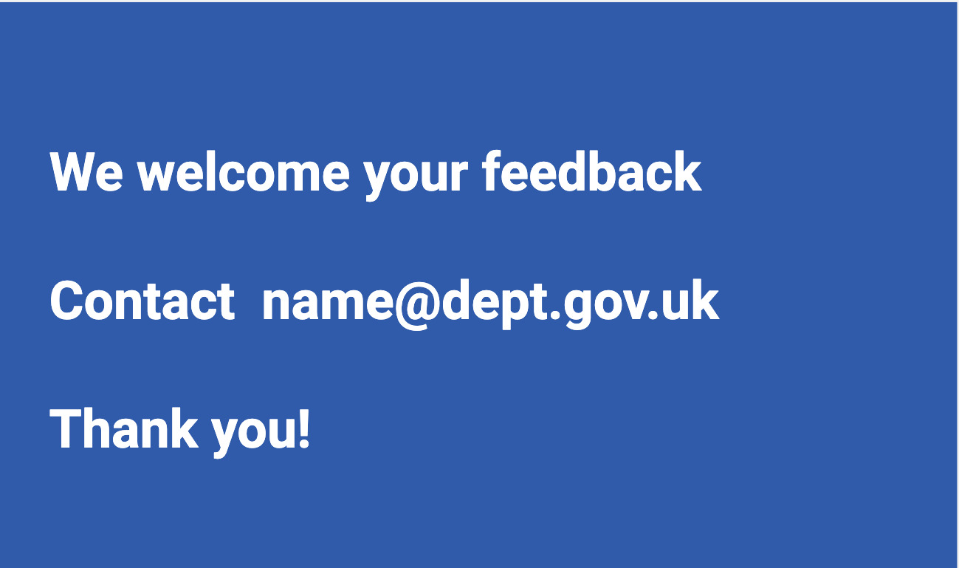
Example: Turning the ecosystem visual into a deck (3)
Notes:
I have another part to explain the internal aspects of the delivery of the service, and some areas which were a shape on the visual. I often have one or more slides about the policy and legal aspects, names of the teams and links to related legislation when relevant, and I have a part on the system and tools, where I explain who uses them.
Finally I invite for feedback so I can improve when things were missing, incorrect or confusing.
I get more feedback that way, especially from people in operations.

Slide 33
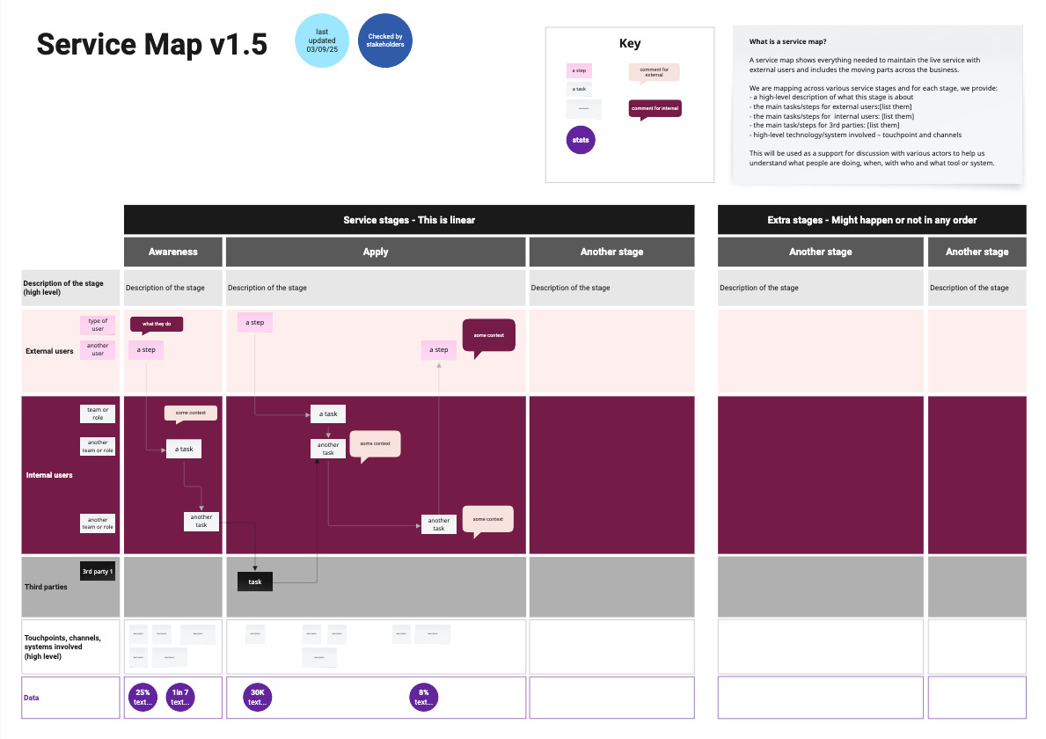
Example:
A service map
Notes:
Again, I cannot share an actual map, but I’ve recreated one. This time it’s a service map.
I have a version number, and in the top right corner, I explain what a service map is and what we will use this for, I provide a key for the colours and shapes I’m using and I also add the date when it was last updated, and also say if it’s has been checked by stakeholders or not.
The map itself show the usual elements I have in a service map:
The column are each stage of the service, some are linear, here I’ve put awareness, apply, and another stage - And then more stages which might happen or not in any order.
For the rows, I have a first row that describe each stage at a high level, then a row for the external users and sub rows if there are different types, then one for internal users, again I might have different layers for different type of internal actors. I often have an extra row for third parties delivering the service too
Under this, I have a row for the touchpoints, channels and systems involved at a high level and finally, a row where I add a bit of data when I have it about this specific stage. Across all this, I have boxes explaining tasks, events and arrows connecting them to understand the flow of the steps.
Once the mapping is in a good place, and I want to start sharing wider, I create an alternative format as a slide deck - But this time, I slice the mapping differently.

Slide 34
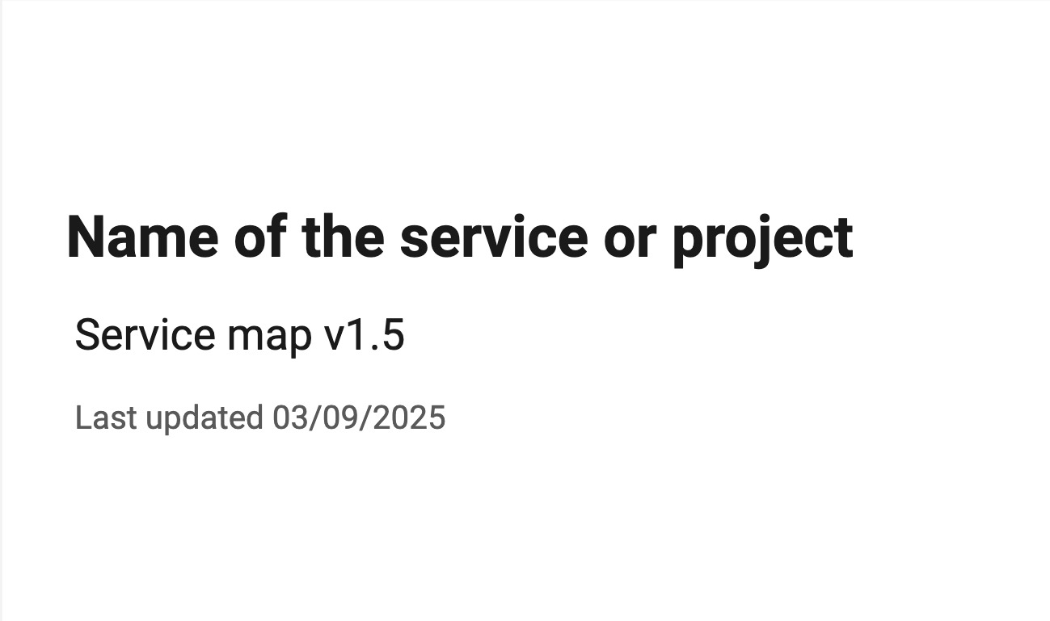
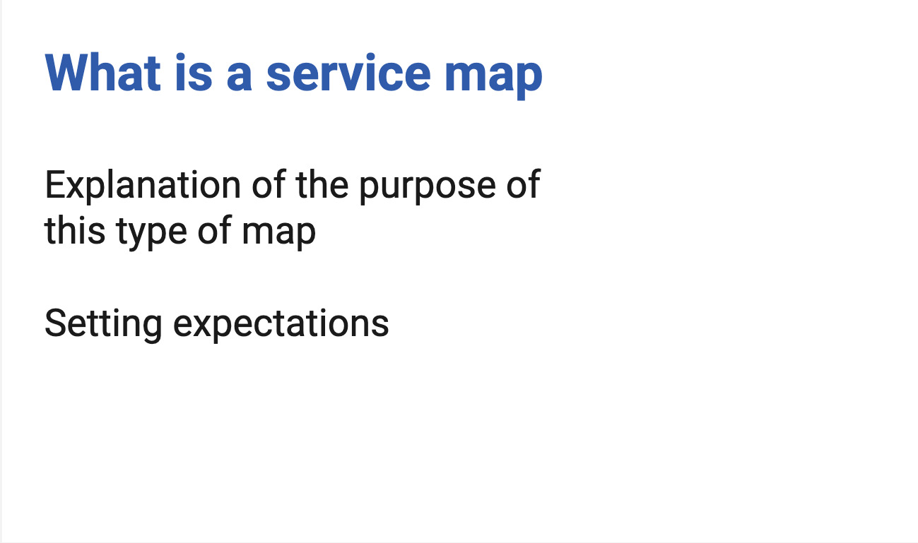
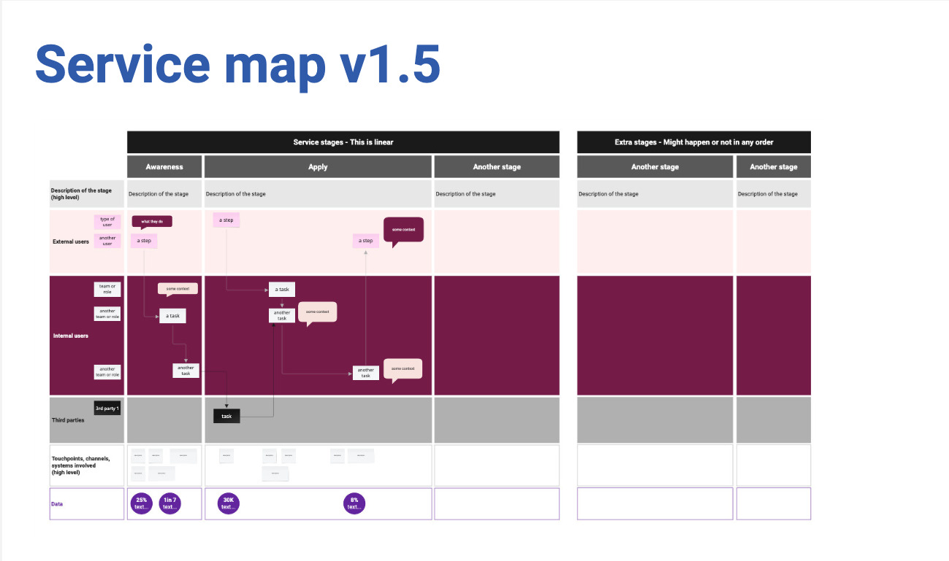
Example: Turning the service map visual into a deck (1)
Notes:
I still have an ‘educational part’ to the document and provide a link to a PDF version of the visual as some people might still be interested in seeing it, and then I provide a written description of the visual.
[explain what a service map is]
A service map shows everything needed to maintain the live service with external and internal users and includes the moving parts across the service.
We are mapping across various service stages and for each stage, we provide:
a high-level description of what this stage is about
the main tasks/steps for external users, internal users and 3rd parties
high-level technology/system involved – touchpoint and channels
This will be used as a support for discussion with various actors to help us understand what people are doing, when, with who and what tool or system are used

Slide 35
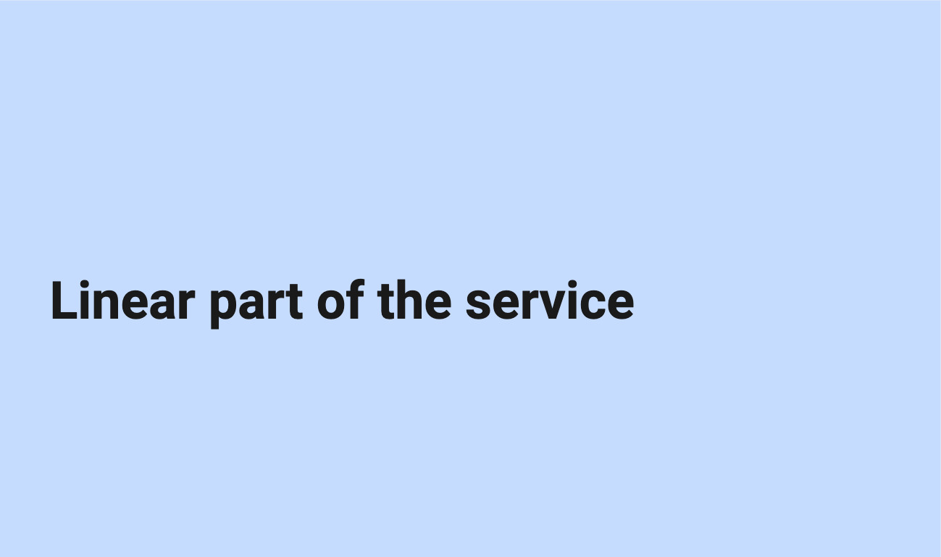
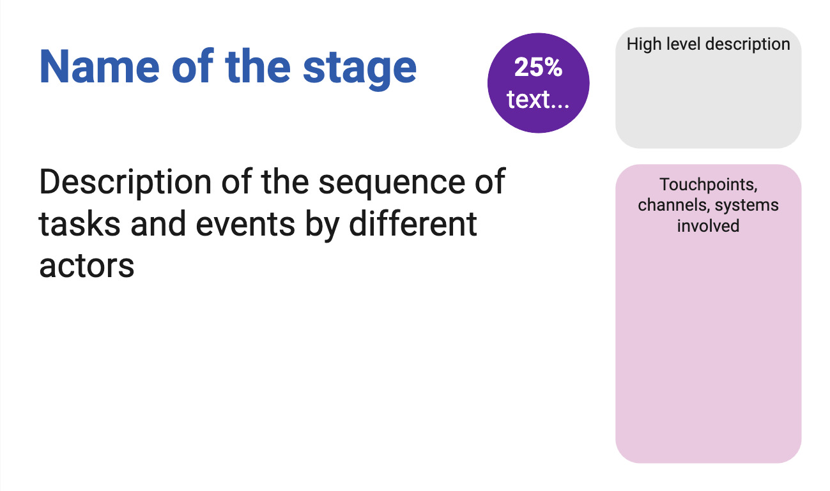
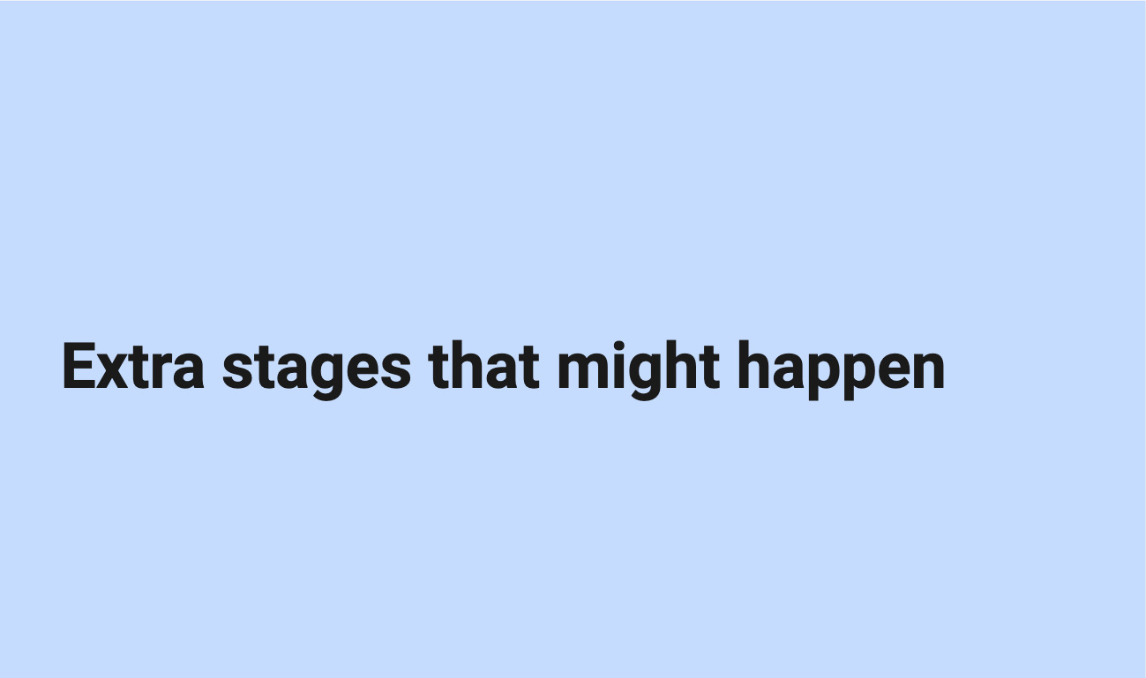
Example: Turning the service map visual into a deck (2)
Notes:
I start with the linear parts of the service and for each stage, I will provide a description of the sequence of tasks and events by different actors, I’ll add any data I might have about this step - For example the percentage of users failing to provide the evidence we need, I have a part of the slide where I give a high level description of the stage, and another to mention the touchpoints, the channels and systems involved.
once I’ve described all the stages in the linear part of the service, I have a section for extra stages which might happen or not: it could be about making an appeal to a decision or transferring to another service
And finally like for the other map, I always have a slide inviting for feedback and giving a contact to do so.

Slide 36
Pros and cons of alternative formats
time consuming
need to maintain two formats
→ this is accessible for people who are colour blind, visually impaired and for some neurodivergent types
→ improve my mapping
→more feedback and engagement from people who are not designers
Notes:
not everyone understand visual representations, so text alternative can help.
it improves my mapping as sometimes, while doing the deck I realise that something is not quite right in the visual representation or it makes me realise that actually, there is a relation or a step I do not understand well enough to explain it in a sentence so it needs more work.

Slide 37
Design together

Slide 38
But there are no disabled people in my team
→ many disabilities are not visible
Neurodivergence in tech / creative industry:
→ over 20% - probably up to 50%
→ people sometimes don’t declare their disability
Notes:
You might be thinking, what is she on about? there are no disabled people in my team or among my stakeholders. And maybe you’re right.
But the problem is that people often think of disability as something that is visible and permanent. But many disabilities are not visible: like hearing and sight impairments, chronic pain and many more
Do you remember the statistic for neurodiversity? about 1 in 7 people in the general population but in tech and creative industries, it might be up to 50%
This is not visible. You might not know about it, but you surely should think about it.
Another thing to keep in mind is that people sometime don’t declare their disability to their employer/colleagues for various reasons.

Slide 39
Things can change
actual employees can become disabled
a new joiner might be disabled
→ Make sure your systems, processes and practice are accessible for all

Slide 40
Creating a safe space
Do not force people to disclose a disability or medical condition
→ offer help for everyone
Instead of providing accommodations for disabled people
→ offer various options to all
Invite for feedback and allow people to reach out privately
Notes:
So when you are designing with people, it’s important to create a safe space. Don’t force people to disclose a disability or medical condition. Instead, offer help for everyone.
We talk about ‘accommodations’ for disabled people, but it’s better to offer various options to all instead, so it doesn’t sound like you are making a big effort just for them and that way, it will benefit more people who might not have requested anything even though they might need it.
Invite for feedback, and allow people to reach out privately

Slide 41
Don’t assume you know what is best
People don’t have the same needs even if they have the same condition, and needs vary in different contexts.
always best to ask what would help
have that discussion with the person
do not assume you’re doing the right thing

Slide 42
Manual of me
Examples of sections:
condition I like to work in
time and hours I like to work
best way to communicate with me or provide feedback
things I’m good at
things I might need help with
how I like to be helped
help you tell others what you need
learn about what other people in your team needs
Do not make people share more than they are willing to!
Notes:
A ‘manual of me’ can be a great tool to communicate what you need to work well with the rest of your team. I’ve been doing this in project teams for a while and found that it helps me to tell people what I need and also to understand them better.
In there for example, I will explain that I struggle with numbers, names and acronyms if I do not have a visual support for them and you just say them, because I’m French and my brain does the little gymnastic of translating things so it slows me down, but if I have a visual, I instantly recognise it.

Slide 43
Organising/hosting a session
before the session: set expectations, provide an agenda, do it again at the start of the actual session
invite people to tell you if this might not work for them
if using online tools like Mural or Miro, plan for an alternative
if over an hour → plan for a break and stick to it
repeat the question someone asked before answering unless you’re sure everyone has heard/seen it

Slide 44
Presenting during a session
share your slides at the start of a presentation or in your invite
keep content short and simple, test the accessibility of the deck
use a mic, speak facing your audience, camera on if online
leave some space at the bottom of your slides
describe any image/ diagram, assume at least one person cannot see
don’t assume people can read the text on slides

Slide 45
Getting people in a venue
access to toilets
enough space to move around
can the light be controlled
sitting arrangement - standing
provide photos or video of the space, and how to get there
plan more time!
Notes:
Earlier, I provided guidance from Scope about physical accessibility at a venue and they have an accessible events toolkit

Slide 46
Key takeaways

Slide 47
Designing for everyone - recap
think about accessibility right from the start
do not forget about internal users
consider neurodivergence and low numeracy in particular
ask for feedback
focus on: integration with other services, questions, consistency
Notes:
accessibility should be addressed right from the start and all along, this includes neurodiversity
make sure anyone can give feedback in a way that suits them, so you can learn how to improve and keep iterating

Slide 48
Design communication - recap
provide alternative formats for your visuals and maps
check colour contrast especially for your text
do not rely on colour alone to convey meaning
use plain language and explain acronyms
be careful with numbers
use accessibility checkers for your slides and word documents
send your presentation ahead of the meeting

Slide 49
Designing together - recap
do not assume there are no disabled people in your team
consider neurodivergence
do not assume you know what is best
use manuals of me

Slide 50
Resources

Slide 51
About Accessibility and neurodiversity
Past videos (of the Accessibility Scotland conference)
Inclusive Design 24 online and free
Public neurodiversity support center
The Neurocrats: Civil Service Live podcast on YouTube
Estimate how many people using your website might be disabled

Slide 52
Guidances
DWP Accessibility manual
Accessibility and inclusive design manual from the Department for Education
Scope: checking the accessibility of an event or venue and accessible events toolkit
Accessible numbers project
Why you need to make your maps accessible - GOV.UK Blog post

Slide 53
Thank you!
To Craig Abbott, Tom Napier, Alice Forward, Lindsay Stephens, Shalom Jesusanmi, Helen Spires, and the whole DWP Service Design Community
And thank you for listening!

Slide 54
Any question?
Get in touch:
stephanie.krus2@engineering.digital.dwp.gov.uk
Or on the cross gov Slack

